Slide 1
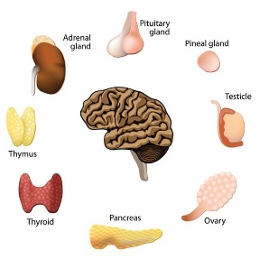
University of Basrah Ministry of Higher education Al-Zahraa Medical College and Scientific Research
Block: Metabolic block
Lecture: Renal involvement in systemic disease
Lecturer: Dr.Mohammed Adel
Block staff:
Dr.Ahmed jaafer (block leader) Dr.Ahmed qasim Dr. Majid hameed dr. mohammed Adel
Dr. Daihgum imad Dr.Ahmed ibraheem Dr. Mohammed mehdi Dr .Ammar mohammed
Davidson's Principles and Practice of Medicine
HARRISON’S PRINCIPLES OF INTERNAL MEDICINE
WILLIAMS textbook of ENDOCRINOLOGY
PEDIATRIC PRACTICE Endocrinology
Oxford Handbook of Endocrinology and Diabetes

Slide 2
Renal involvement in systemic conditions:
The kidneys may be directly involved in a number of multisystem diseases or secondarily affected by diseases of other organs.
Involvement may be at a pre-renal, renal (glomerular or interstitial) or post-renal level.

Slide 3
Diabetes mellitus
Diabetic nephropathy is the most common cause of CKD in developed countries.
In patients with diabetes, there is a steady advance from moderately elevated albuminuria (microalbuminuria) to dipstick-positive proteinuria, in association with evolving hypertensive and progressive renal failure.
Few patients require renal biopsy to establish the diagnosis, but atypical features such as very rapid progression of proteinuria/decline in renal function or the absence of other microvascular damage, including retinopathy, should lead to suspicion that an alternative condition could be present.
Management with ACE inhibitors and ARBs to slow progression.
Emerging evidence suggests that SGLT2 inhibitors, such as empagliflozin, a new agent for diabetes that causes glycosuria

Slide 4
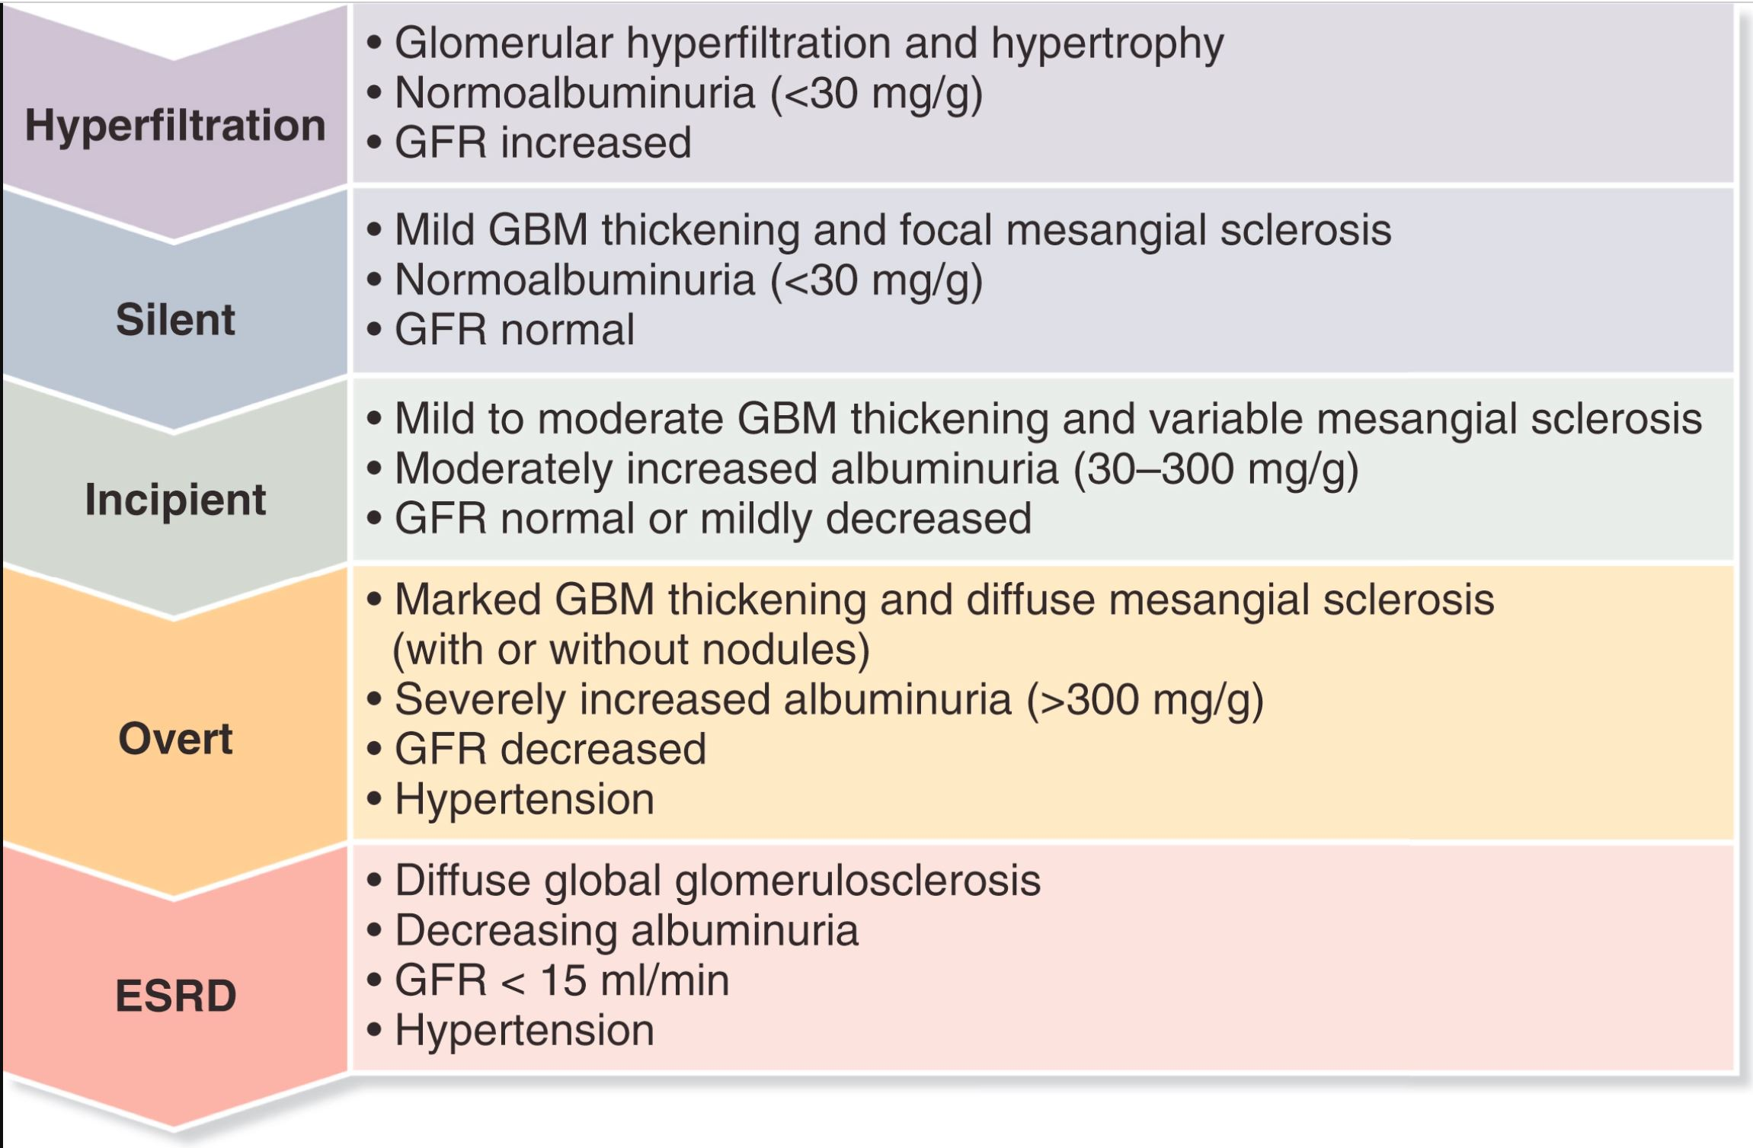
Stages
Of
Diabetic
Nephropathy

Slide 5
Systemic lupus erythematosus
Subclinical renal involvement, with non-visible haematuria and proteinuria but minimally impaired or normal renal function, is common in systemic lupus erythematosus (SLE).
Usually, this is due to glomerular disease, although interstitial nephritis may also occur, particularly in patients with overlap syndromes such as mixed connective tissue disease and Sjögren’s syndrome.
Almost any histological pattern of glomerular disease can be observed in SLE and the clinical presentation ranges from florid, rapidly progressive glomerulonephritis to nephrotic syndrome.
The most common presentation is with subacute disease and inflammatory features (haematuria, hypertension, variable renal impairment), accompanied by heavy proteinuria that often reaches nephrotic levels.

Slide 7
Vasculitis:
Small-vessel vasculitis commonly affects the kidneys, with rapid and profound impairment of glomerular function.
Histologically, there is a focal inflammatory glomerulonephritis, usually with focal necrosis. and often with crescentic changes.
Typically, the patient is systemically unwell with an acute phase response, weight loss and arthralgia.
In some patients, it presents as a kidney-limited disorder, with rapidly deteriorating renal function and crescentic nephritis (a rapidly progressive glomerulonephritis).
In others, pulmonary haemorrhage may occur, which can be life-threatening.

Slide 8
The most important cause is ANCA vasculitis.
Two subtypes are recognised microscopic polyangiitis (MPA),and granulomatosis with polyangiitis.
Both may present with glomerulonephritis and pulmonary haemorrhage, along with constitutional symptoms, Gastrointestinal involvement and neuropathy may also occur.
Serological testing for antibodies to myeloperoxidase (MPO) and proteinase 3 (PR3) is usually positive but these are not specific and a biopsy of affected tissue should be obtained, if possible, to confirm the diagnosis.

Slide 9
The standard treatment of glomerulonephritis associated with systemic vasculitis is high-dose glucocorticoids combined with cyclophosphamide, or mycophenolate mofetil.
Recent studies indicate that rituximab when combined with highdoseglucocorticoids, is as effective as oral cyclophosphamide and high-dose glucocorticoids in the treatment of ANCA-associated vasculitis.
Plasma exchange can offer additional benefit in patients with progressive renal damage who are not responding adequately to immunosuppressive therapy.

Slide 10
Thank you

